Slide 1

CAPSTONE FINAL PRESENTATION
Predicting used cars price
GROUP- 6

Slide 2
Problem Statement :
The used cars industry is one of the slowly growing industries which deals with refurbished cars at a lower discounted rate.
There are many private companies which sell budget cars which have been listed on websites
like Car Dekho, Spinny, CarTrade etc.
Companies like Big Boyz Toyz, The 6th Gear provide deals on refurbished luxury cars, which are a big deal in the current generation of business entrepreneurs in India.
The used car industry does not limit to only the lower sections of the society to purchase a
car, but it also applies to the higher section of the society who can grab big
deals on luxury and super cars.
DATA SOURCE
Kaggle – Data Society

Slide 3
Dataset Description
* dateCrawled: Date the car advertisement was crawled. (Date)
* name: Name of the car. (String)
* seller: Type of seller (private or dealer). (String)
* offerType: Type of offer (e.g. sale, repair, etc.). (String)
* price: Price of the car. (Integer)
* abtest: Test type (A or B). (String)
* vehicleType: Type of vehicle (e.g. SUV, sedan, etc.). (String)
* yearOfRegistration: Year the car was registered. (Integer)
* gearbox: Type of gearbox (manual or automatic). (String)
* powerPS: Power of the car in PS. (Integer)
* model: Model of the car. (String)
* kilometer: Kilometers the car has been driven. (Integer)
* monthOfRegistration: Month the car was registered. (Integer)
* fuelType: Type of fuel (e.g. diesel, petrol, etc.). (String)
* brand: Brand of the car. (String)
notRepairedDamage: Whether or not the car has any damage that has not been repaired. (String)
* dateCreated: Date the car advertisement was created. (Date)
* nrOfPictures: Number of pictures of the car. (Integer)
* postalCode: Postal code of the car. (Integer)
* lastSeen: Date the car was last seen (crawler lastscan his particular post online) (Date)

Slide 4
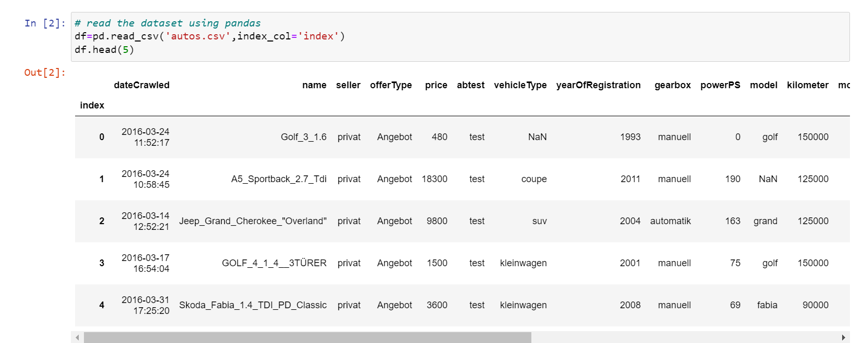
Solution for Defined Problem
Loading the data set

Slide 5
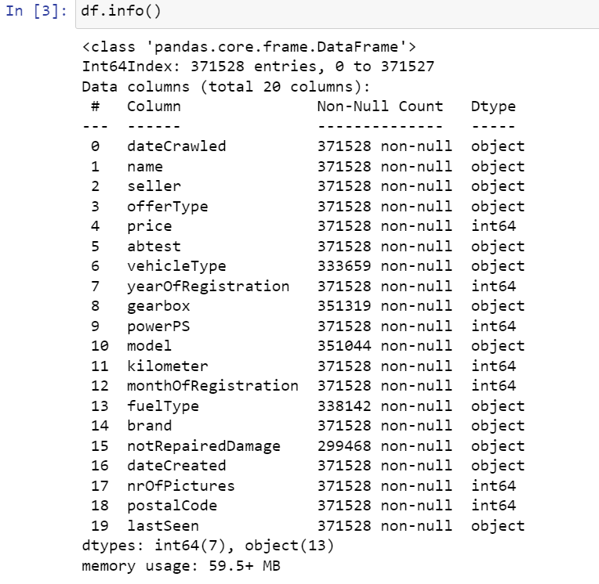
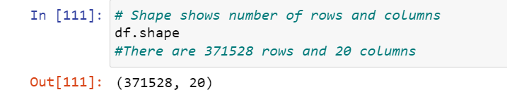
Make the data proper to make use of data for analysis
Identify the Features data types and shape of the dataset
There are 7 numeric columns and 13 categorical columns out of which 3 are datetime data type.

Slide 6
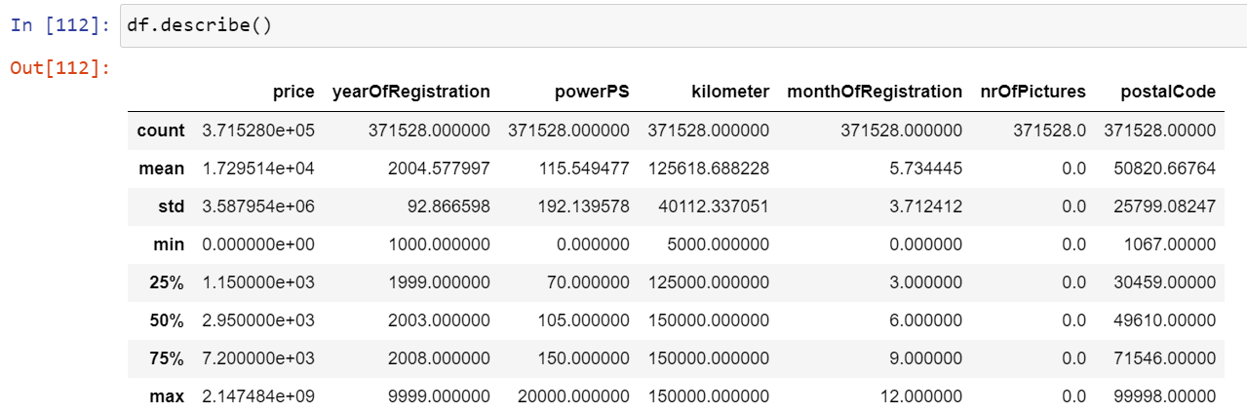
Five Point Summary
There are 5 feature with int and 2 of them are year columns
min price is 0
yearOfRegistration - min is 1000 and max is 9999 , its incorrect as year cant be such numbers
powerPS - mean is 105,max is very high ,i,e 20000
Mininum nuber of kilometers the car has ran is 5000kms and maximum is 150000kms
no of picttures feature has no values, it has only 0, its s a insignificant variable

Slide 7
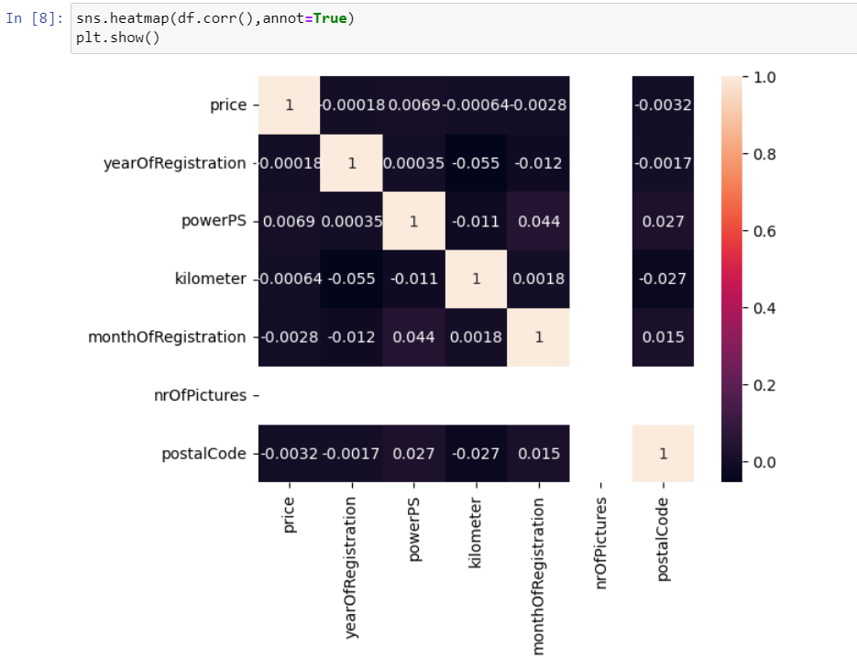
Heatmap
There is no high correlation between the dependent and independent variables.

Slide 8
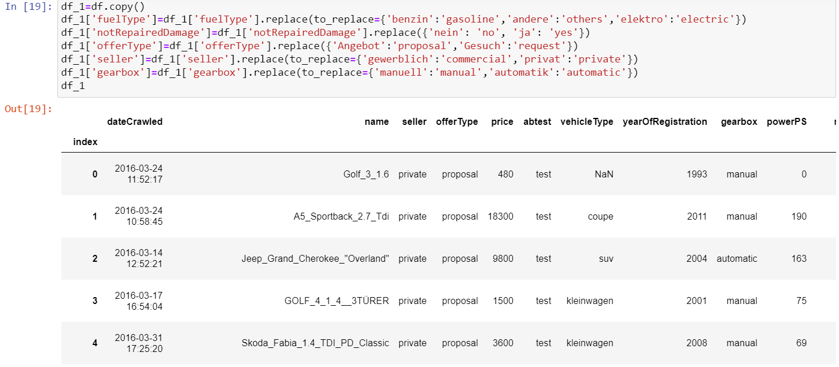
Changing the names of the strings for better understanding
Replacing the values for better understanding

Slide 9
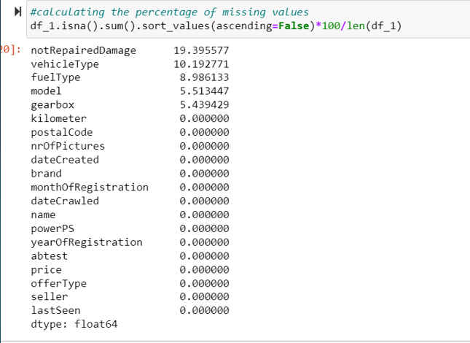
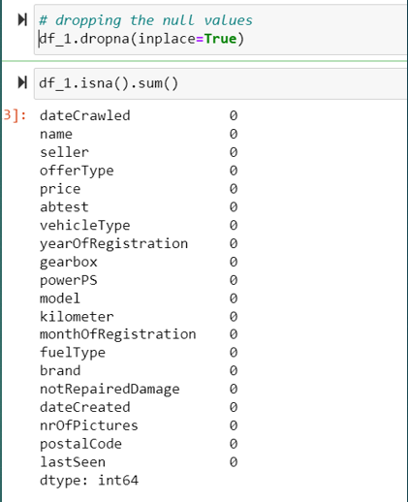
Calculating the percentage of missing values and dropping it
We have dropped the missing values , since it is less than 20%
And Imputing it may effect the data

Slide 10
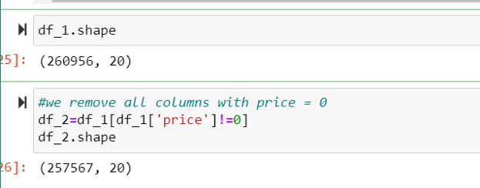
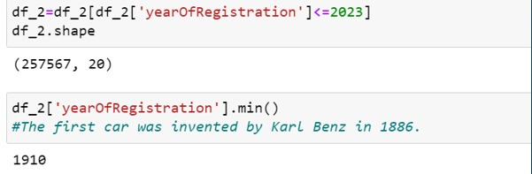
Filtering the data
A. Based on price
Price had Negative values , so we have taken
price greater than 0
After filter we have 257567 rows and 20 columns
B. Based on Year of Registration
We have taken the year from 1910 - 2023

Slide 11
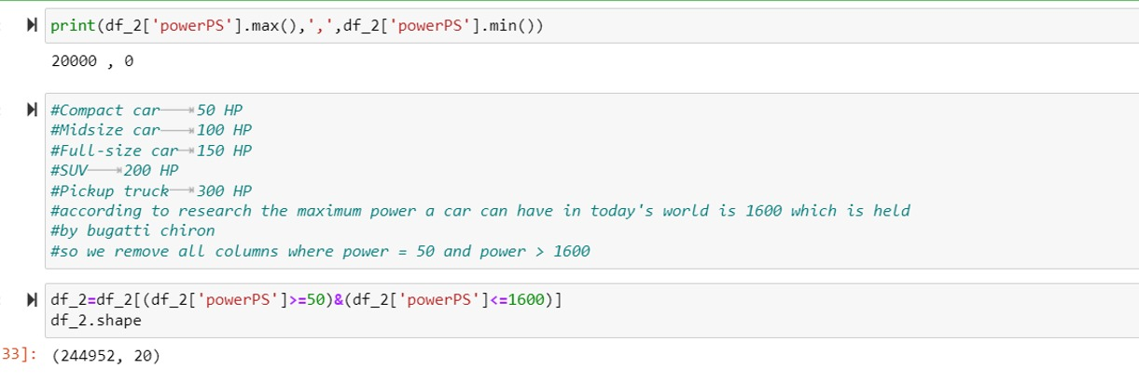
C. Based on Power PS
Considering min as 50 and max as 1600
your own text

Slide 12
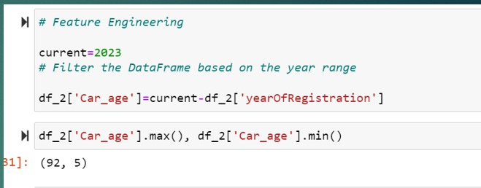
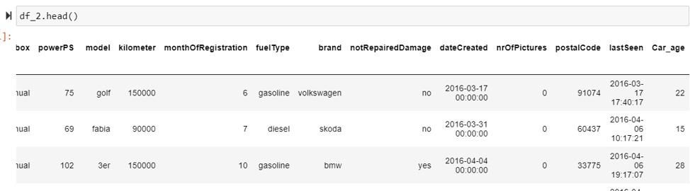
Feature Engineering
Getting the age of the car using the registration column
Minimum is 5 and max is 92

Slide 13
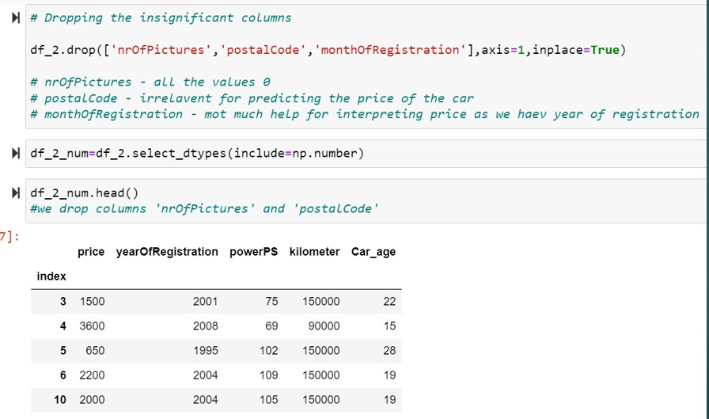
Dropping insignificant numerical columns

Slide 14
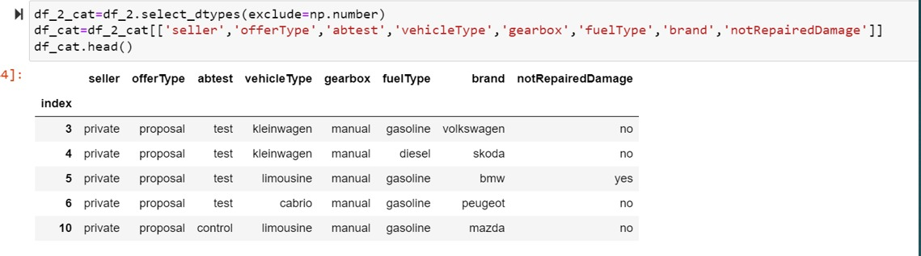
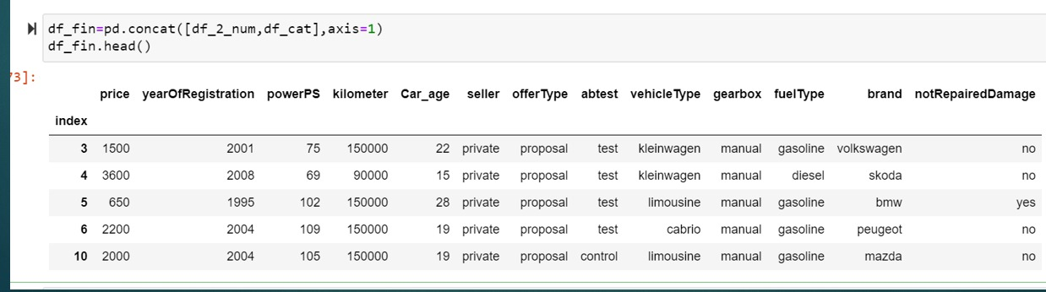
Selecting relevant categorical columns and concatenating

Slide 15
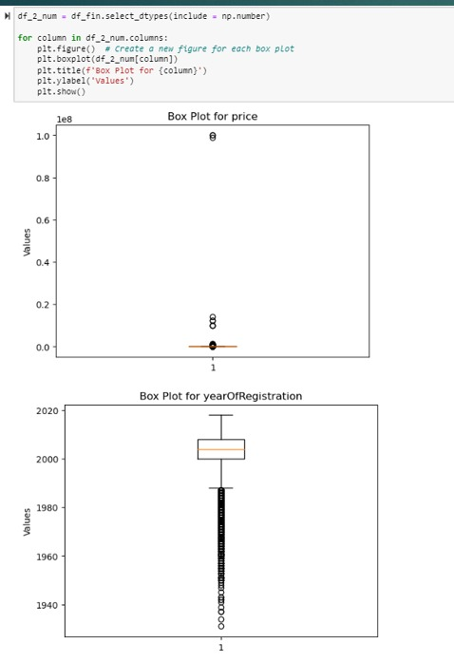
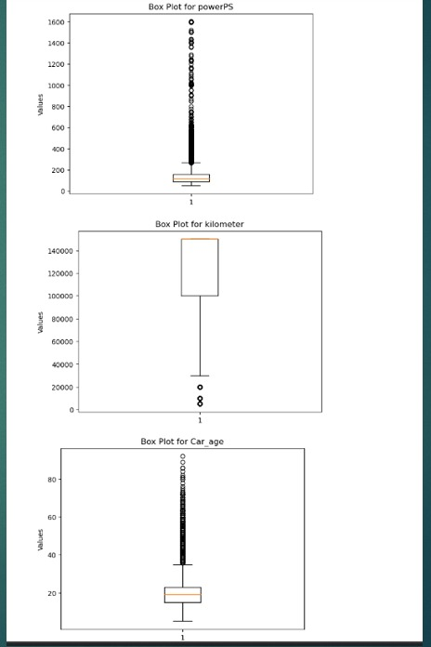
Outlier Detection
Using box plot we used to find the outliers within the dataset

Slide 16
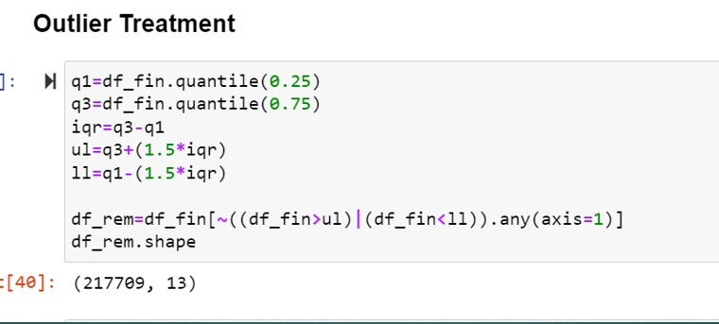
Outlier Treatment
Outliers are treated with Interquartile Range Method
The interquartile range is the middle 50% of the dataset.
It ranges between the third and the first quartile.
Also we use the interquartile range, first quartile and third quartile to identify the outliers.
The outlier is a point which falls below Q1 - 1.5 * IQR or above Q3 + 1.5 * IQR.

Slide 17
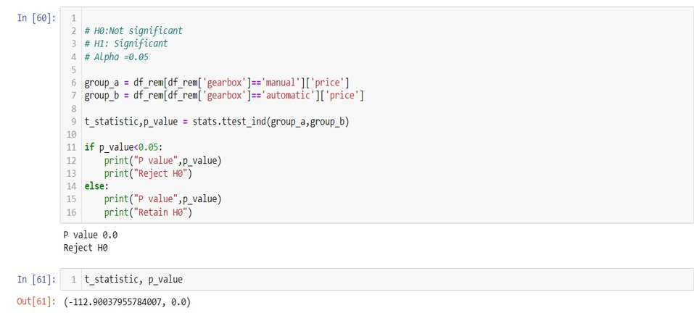
Statistical Tests
Is the variable gearbox significant in getting the price.
The output indicates that the p value is less than the significant value we are
rejecting H0.
Hence gearbox is a significant variable

Slide 18
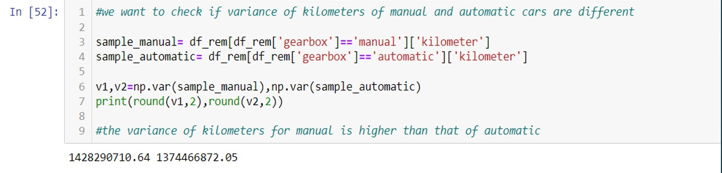
We wish to determine whether the variation of kilometer between manual and automatic vehicles differs.
Here the variance of kilometers for manual is higher than that of automatic

Slide 19
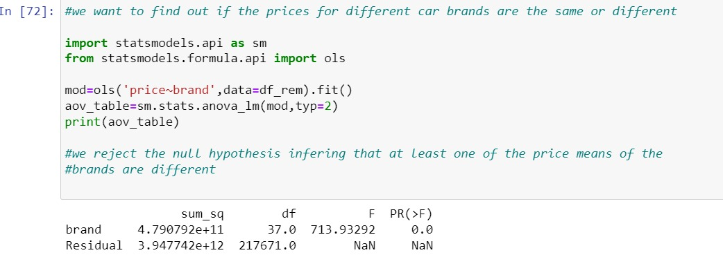
To determine whether costs for various car brands are comparable or not
we reject the null hypothesis inferring that at least one of the price means of the
brands are different

Slide 20
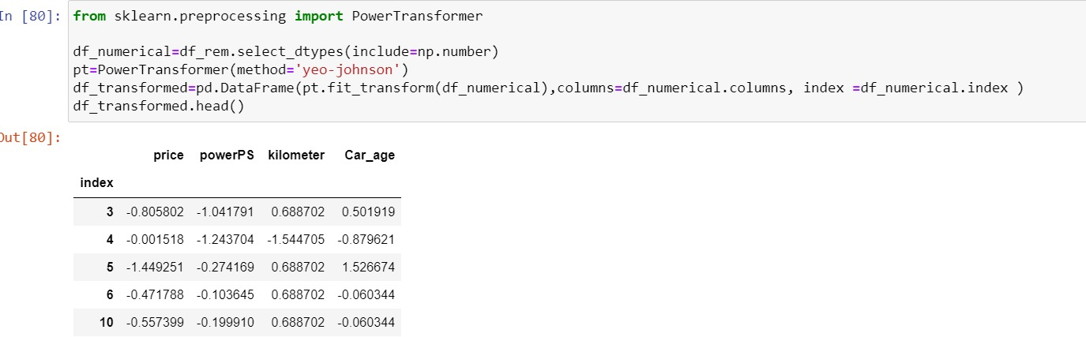
Transforming the data
Here we are transforming data using yeo-johnson method.
Our Dataset doesn’t follow normal distribution so that transformation make machine learning
algorithms becomes valid.
Yeo-Johnson can be used when the data has negative values.

Slide 21
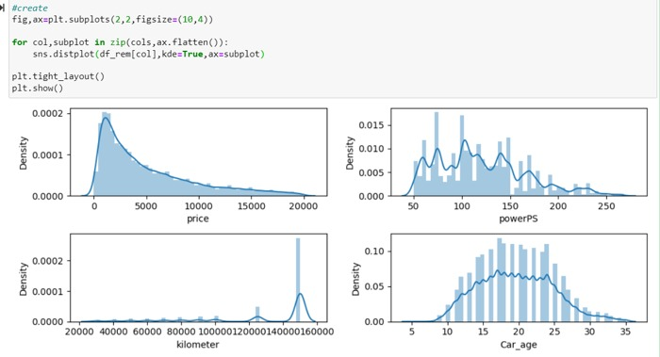
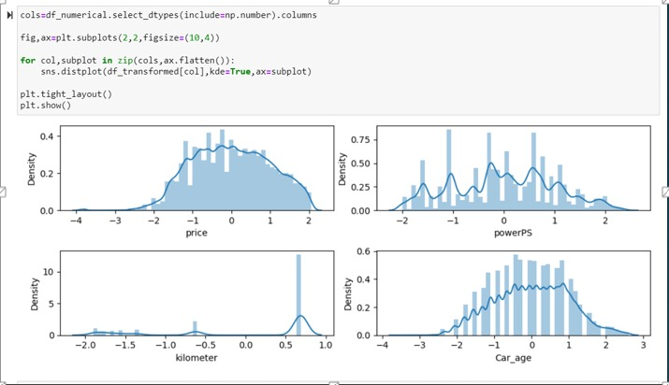
Distribution of data before and after transformation

Slide 22
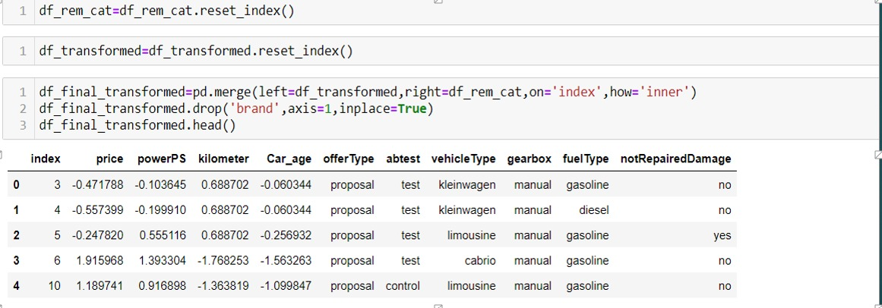
Merging the transformed data with the categorical variables

Slide 23
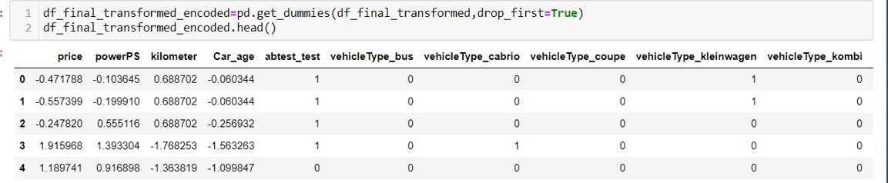
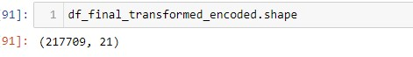
Getting dummy values from the final transformed encoded data
We used dummy encoding for a categorical variable.
It can take k values and, k-1 dummy variables are created.

Slide 24
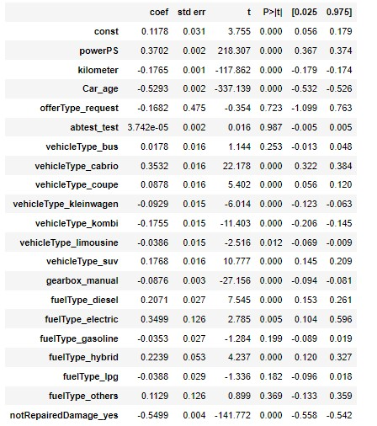
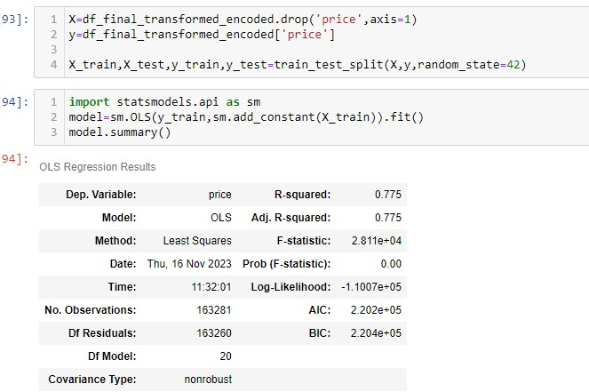
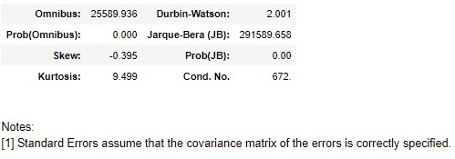
Splitting the data Model building

Slide 25
Assumptions
Target is numeric- Estimating the ‘Price’ of used cars.
Linear Relationship -There is no linear relation between dependent and independent variables.
Multicollinearity - There is low multicollinearity 188 is the condition number.
Autocorrelation -There is no autocorrelation. The Durbin-Watson score we got is
1.98 ( range is 1.5-2.5)

Slide 26
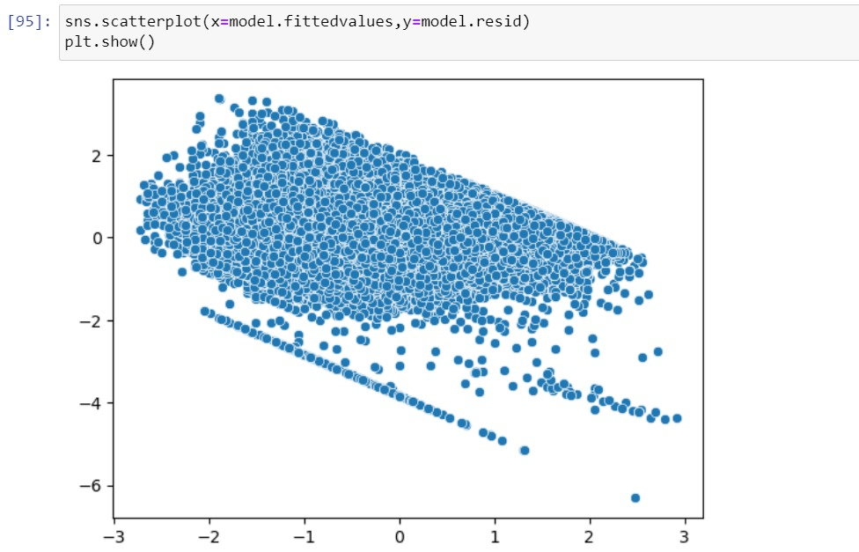
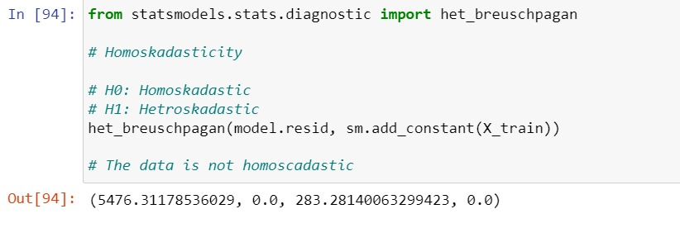
5. Homoscedasticity - Model is heteroscedastic.
We reject H0, p value <0.05,
hence the model is hetroscedastic
Model – fitted values on x axis and
the residuals on the y axis

Slide 27
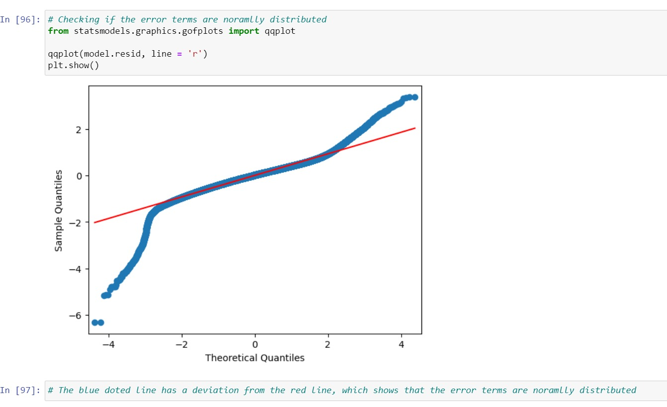
6. Residuals are not normally distributed.
Qqplot of the residuals
The blue doted line has a deviation
from the red line, which shows that the
error terms are normally distributed

Slide 28
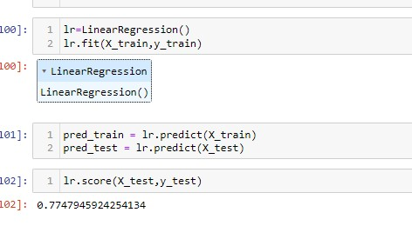
Model – Linear Regression
Linear regression is used for modeling
the relationship between a dependent
variable and one or more independent
variables by fitting a linear equation to
the observed data.
y = B0 + B1x + E

Slide 29
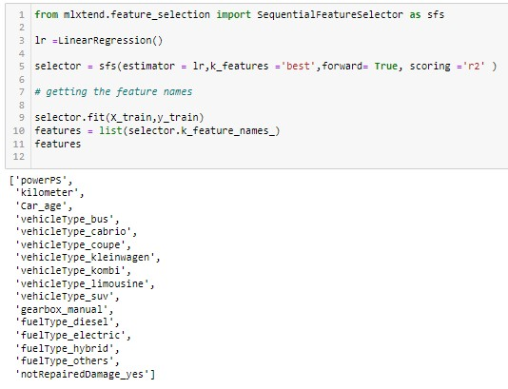
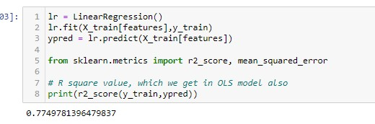
Model – Sequential Feature Selection
SFS is to select the subset of features from a given set based on their contribution to
the performance of a model.

Slide 30
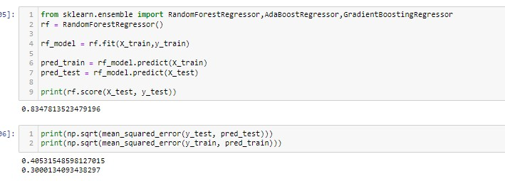
Model – Random Forest Regressor
Random forest regressor is a powerful and flexible algorithm that generally requires less parameter
tuning compared to individual decision trees.

Slide 31
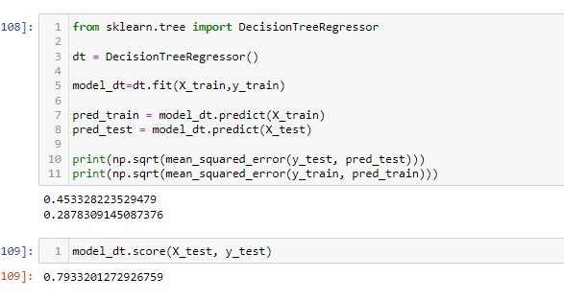
Model – Decision Tree Regressor
Decision tree regressor works by recursively partitioning the training data into subsets based on the values of input features, and it predicts the target variable by averaging the target values of the
instances in the leaf node.

Slide 32
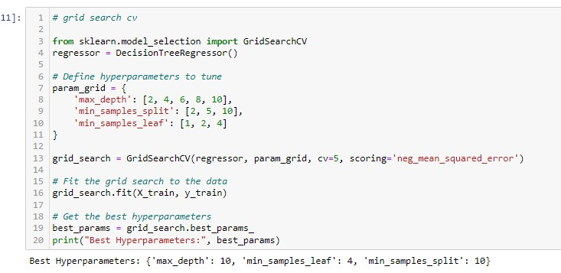
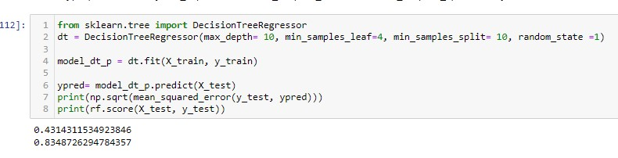
Model – Decision Tree with grid search cross validation
Grid search cv is for tuning hyperparameters of a
model by searching over a predefined set
of hyperparameter values.
It uses cross-validation to evaluate the
performance of each combination.

Slide 33
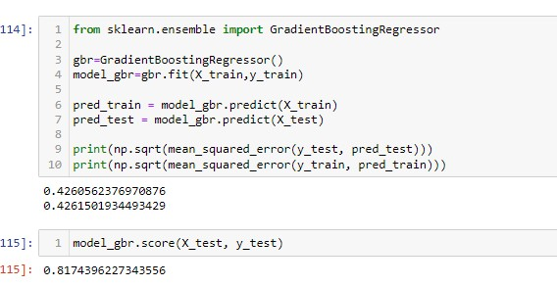
Model – Gradient Boosting Regressor
Gradient Boosting is an ensemble learning method, for decision trees with each
tree correcting the errors of the previous one.

Slide 34
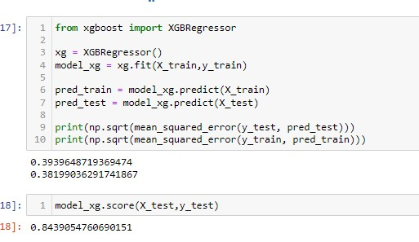
Model – XGBooster
XGBooster is responsible for handling boosting process and keeping track of the model parameters
during training.

Slide 35
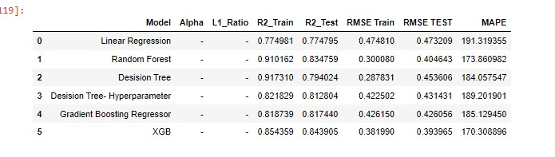
Final Model
The final model (XGBooster) outperformed the base model by a considerable margin.
Our model rmse was reduced from 0.47 to 0.39 and score of the
model increased from 0.77 to 0.84.
The model provides a reliable and transparent price to the buyers and sellers in the used cars market.

Slide 36
Submitted by: (Group – 6)
Mr. ADARSH B
Ms. ALKA CHAUHAN R
Ms. SAI SRIVALLI SREEDEVI KOLACHENA
Mr. DINESH KUMAR
Mr. GAGAN
Mentor :
Mr. CHANDRAN VENKATESAN

Slide 37
THANK YOU

